Slide 1

Detecting AI-Generated Text: A Novel Ensemble Approach
Nick Kornienko

Slide 2

The Rise of Generative AI and Its Challenges
AI's ability to generate sophisticated text indistinguishable from human writing
Risks: Misuse for creating false information, phishing emails, and fake news
Current detection methods are unreliable: prone to missing AI content or false positives

Slide 3

A New Approach to AI Text Detection
Combining predictions from multiple Large Language Models (“Ensemble”)
Simpler yet equally or more effective than existing methods
Aims to reduce false positives and misses in AI text detection

Slide 4
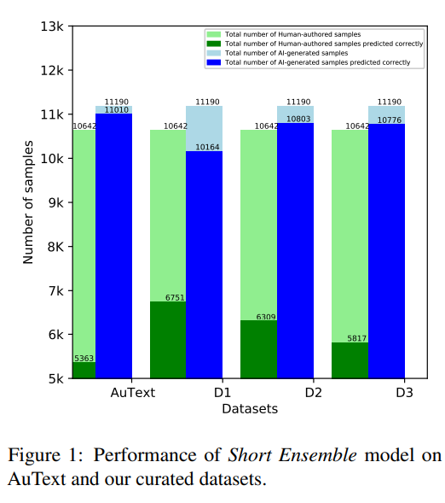
Testing the New Detection Method
Tested on four benchmark datasets for text classification
Improvement ranging from 0.5% to 100% over previous methods
Better performance using unrestricted models like LLaMA2

Slide 5
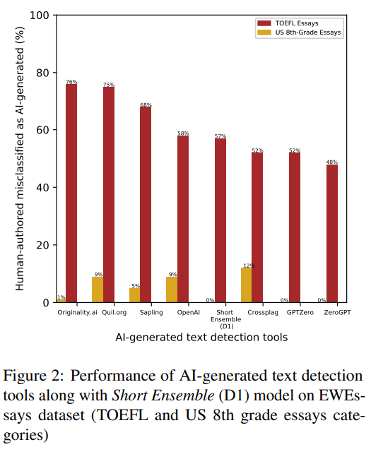
Versatility of the Method
Successfully applied to a dataset of English essays
Demonstrates adaptability for various types of content
Potential for wide-ranging applications

Slide 6
Fairness in AI Detection
Discusses potential bias against non-native English speakers
Need for methods that minimize such biases
Ensuring fair treatment in AI's influence

Slide 7
A Significant Milestone in AI Detection
Marks a major step in accurately detecting AI-generated text
Enhances accessibility for a broader range of users
Opens doors for equitable AI text detection methods

Slide 8
Research Paper Reference
“A Simple yet Efficient Ensemble Approach for AI-generated Text Detection”
https://arxiv.org/abs/2311.03084

